Slide 1
Software Defined Architecture for Secure Video Streaming
BY
Aman Maldar & Priyanka N. Murthy
University of Massachusetts, Lowell
220 Pawtucket St,Lowell,MA-01854

Slide 2
Outline
Motivation and Objective
Introduction
The architecture of CORD
Design
Implementation
Demonstration
Results/ Work Done

Slide 3
Motivation & Objective
Home based healthcare/patient monitoring.
Design Hello World application on CORD.
Design a video streaming service on CORD by running Red5 server.
Evaluate the performance of video streaming

Slide 4
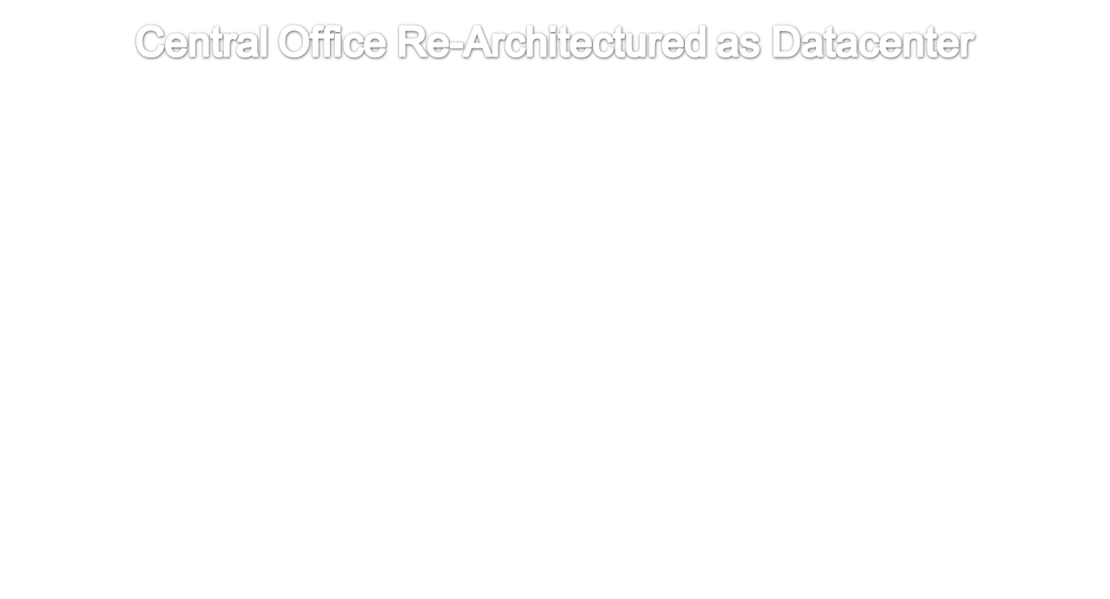
Introduction
CORD
CORD is an end-to-end SDN/NFV/Cloud solution POC for ONOS project that spans Central Office, Access, and home/enterprise.
Enables service providers to build their central offices using commodity hardware to create common underlying infrastructure.

Slide 5

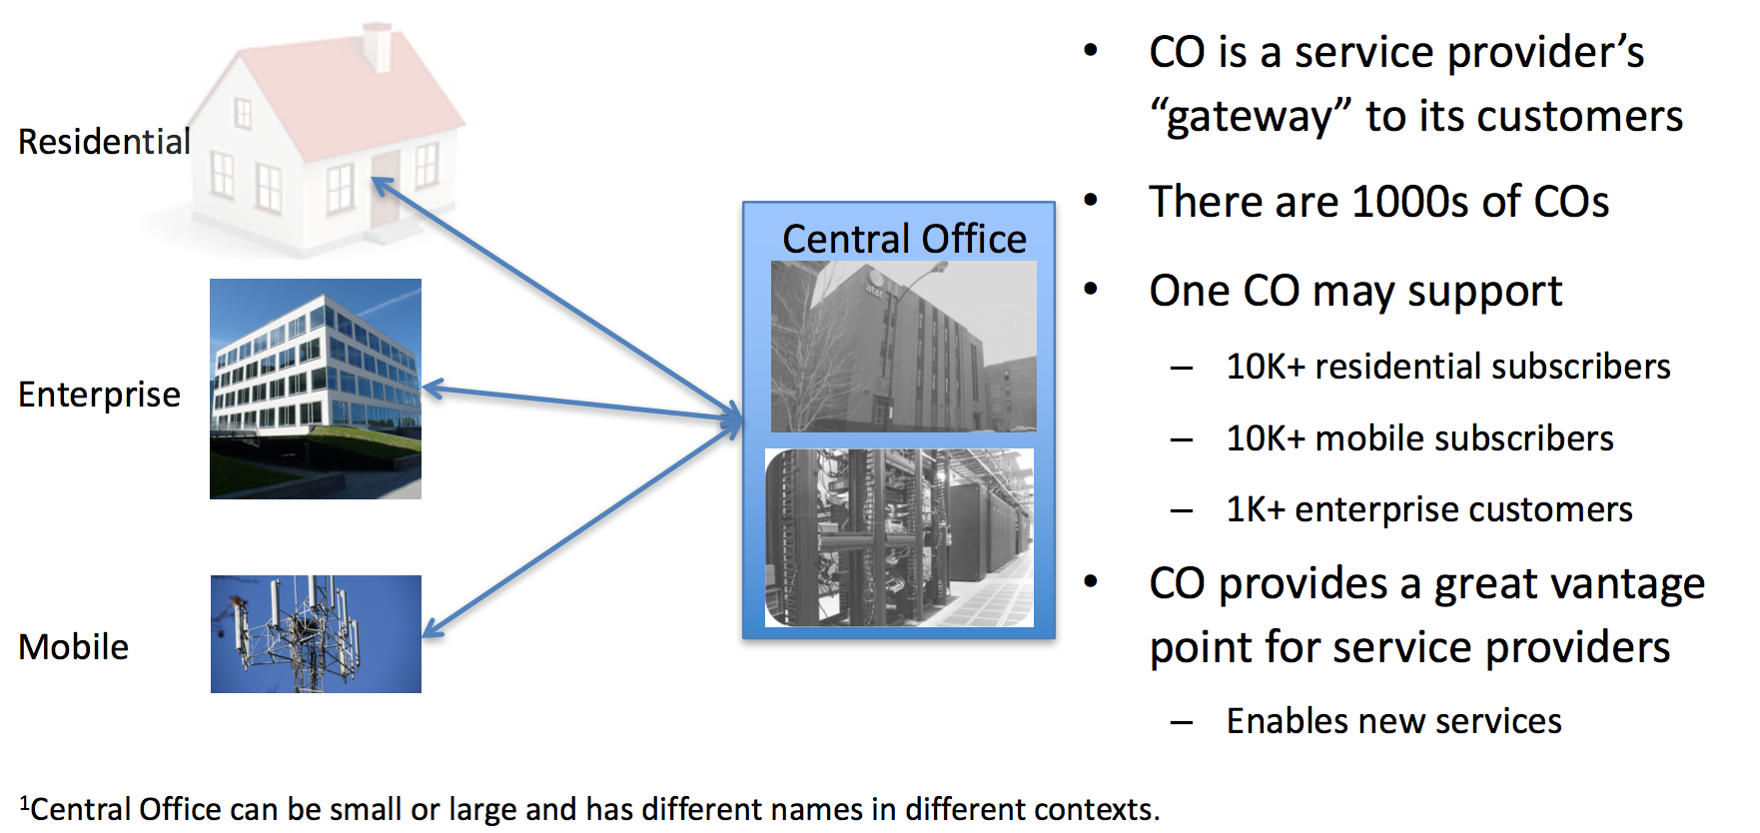
Introduction
CORD

Slide 6
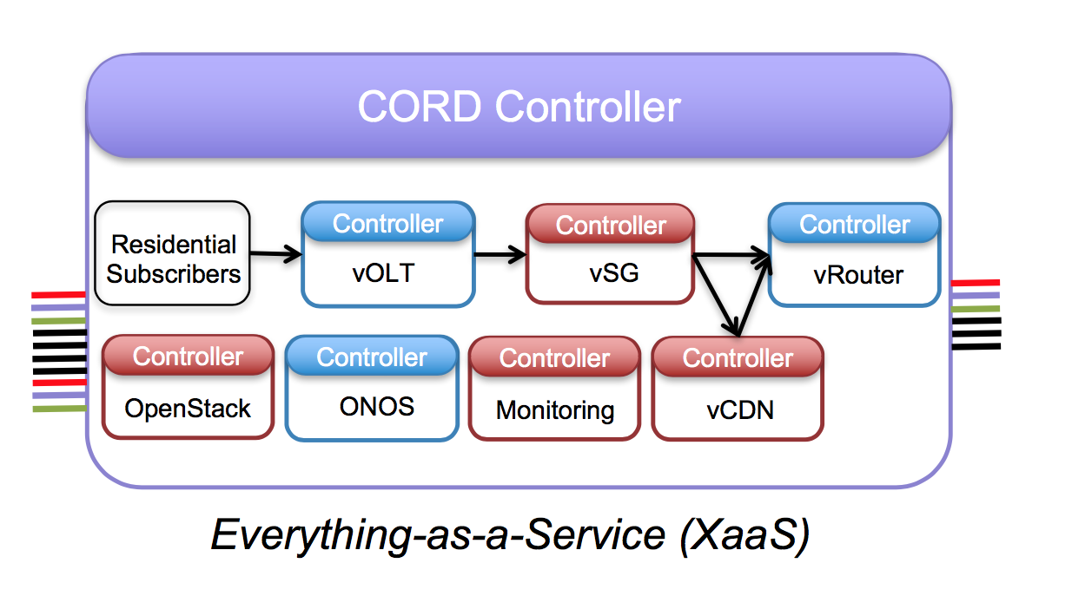
Introduction[1]
CORD

Slide 7
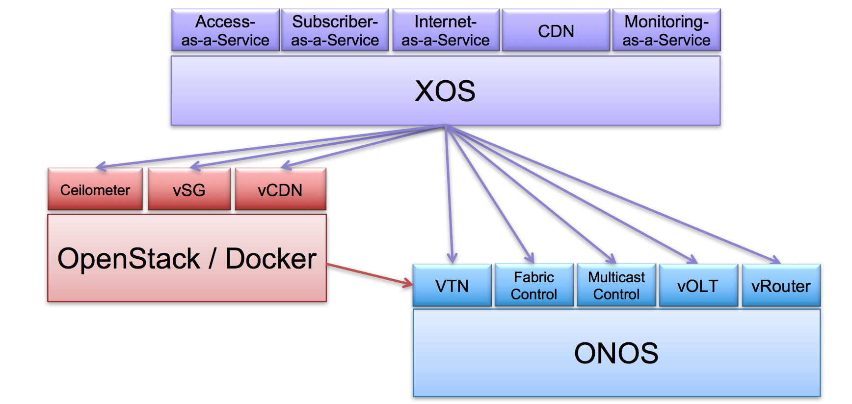
Introduction[1]
Components of CORD

Slide 8
Design
Setting up CORD Environment on CloudLab.
Running Hello World Service.
Setting up Red5 Server on CORD.
Send the stored video stream to CORD service (S1).
Consumer application to read the video stream from CORD service (S2).
Plot the graph for each performance metrics like latency, CPU Utilization.

Slide 9
Implementation Strategies
Container
Deployment tool – Ansible Playbook
Propagate changes to server

Slide 10
Demonstration

Slide 11
Results/ Work Done
Successfully installed CORD production environment.
Learnt to design and implement Hello World Application.
Changes to Hello World application to use as a Service.

Slide 12
References
[1]CORD: Central Office Re-architected as a Datacenter. Larry Peterson Open Networking Lab
[2] https://www.sdxcentral.com/projects/
[3] XOS White Paper

Slide 13
Thank you!

